Slide 1

Active Methodologies and Adaptive Learning
Stephen Downes
November 28, 2019

Slide 2
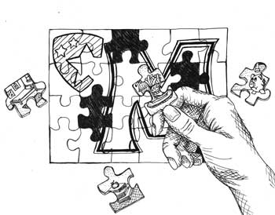
Active learning is not just doing
It involves setting priorities and making plans
It involves evaluating and selecting resources
It involves decision-making
It involves networking, collaboration, and cooperation
It involves creating and sharing
http://www.queensu.ca/teachingandlearning/modules/active/04_what_is_active_learning.html
http://www.crlt.umich.edu/active_learning_introduction

Slide 3


Why? Because active learning is a different type of learning
Traditional learning is based on remembering
It is topic-based and content-based
It is focused on knowledge

Slide 4
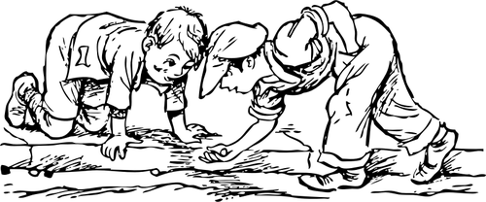
Why? Because active learning is a different type of learning
Active learning is based on growth
It includes, but is deeper than content and knowledge
Students learn how to see and recognize
They acquire a repertoire of tools and responses
One becomes an expert in a discipline; it’s a form of embodiment

Slide 5
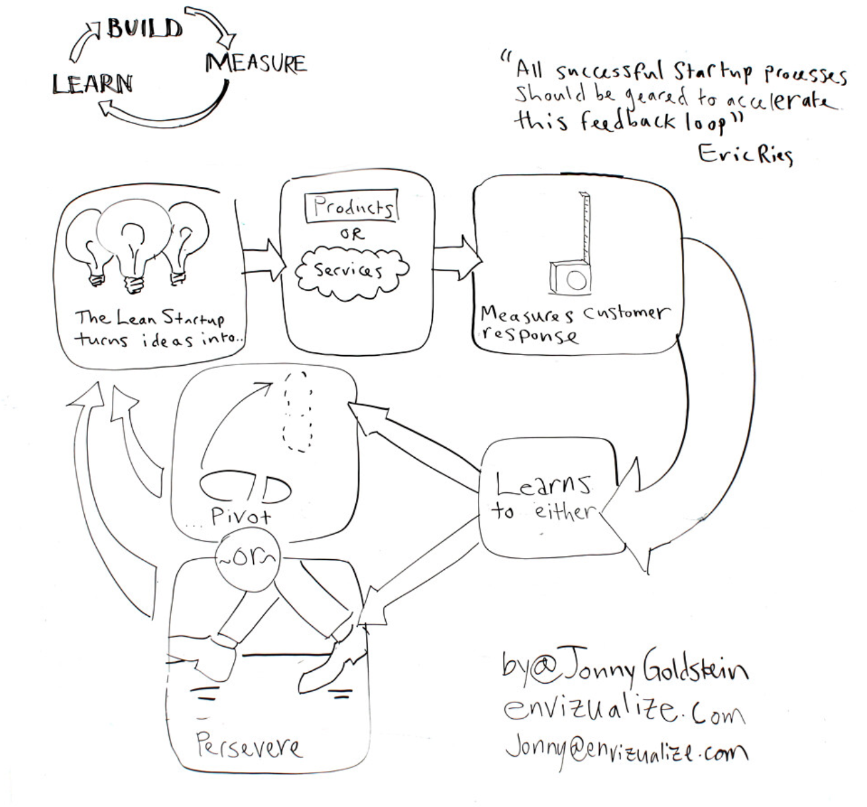
Adaptive Learning
In traditional learning, topics, activities and lessons are designed and selected by the teacher
Adaptive learning substitutes its own decisions for that of the teacher
Is based on a knowledge of the student (based on data, tests, etc)
Selects resources and activities from a set of alternatives
Manages the process of learning using these resources

Slide 6
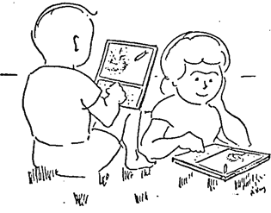
In active learning, these decisions should be made by the learner
It originates in what the student wants to do – goals, strategies
(which is often not known or deemed irrelevant by active learning systems)
https://www.sciencedirect.com/science/article/pii/S0360131517302397

Slide 7
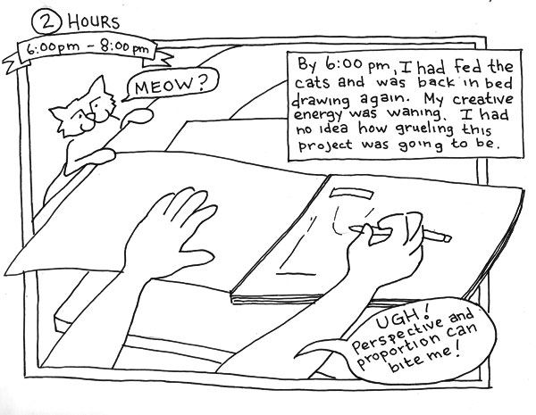
In active learning, these decisions should be made by the learner
Learners own and use their own information -
(which can include data, tests, etc)
What they create, plus
Activity records, plus
Interactions, etc
http://angrybearcomics.blogspot.com/

Slide 8
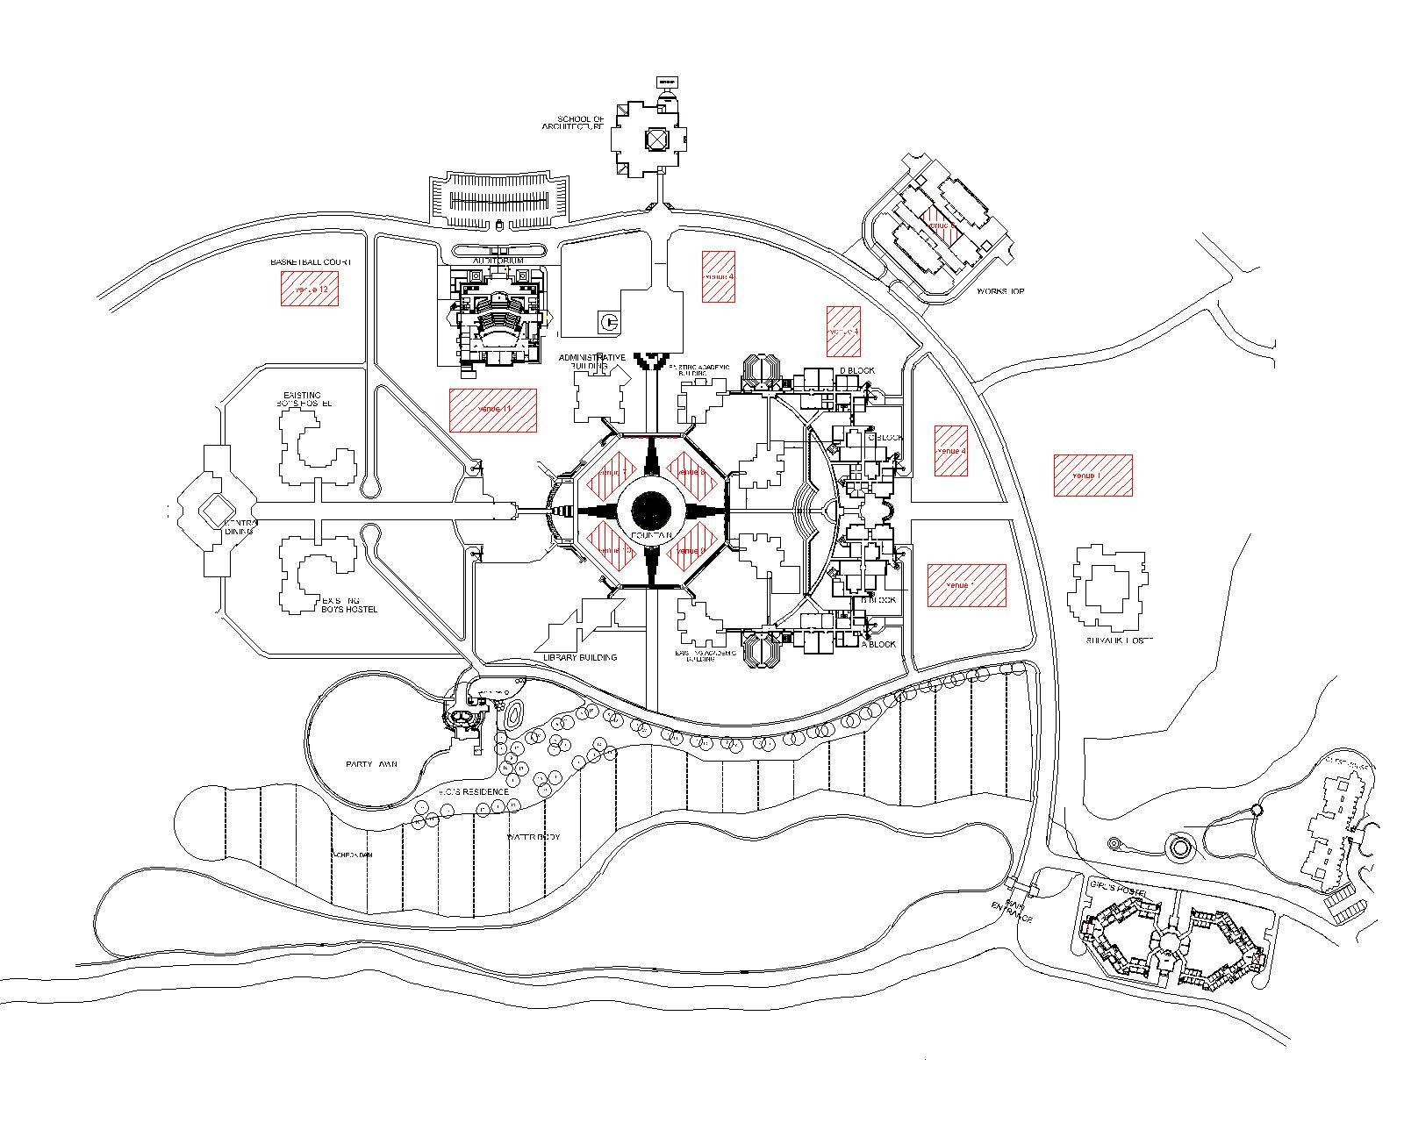
In active learning, these decisions should be made by the learner
Learners select resources and activities from anywhere – goals, content
(Not limited to a set of predefined alternatives)
May be localized or suited to their own background
https://en.wikipedia.org/wiki/Shri_Mata_Vaishno_Devi_University

Slide 9
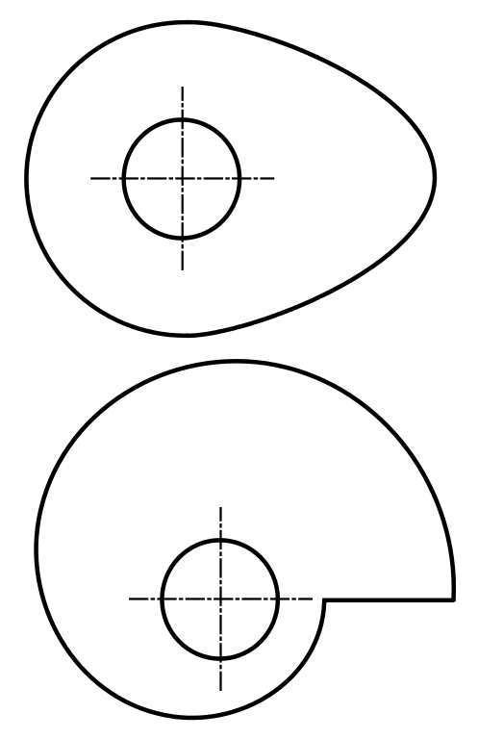
In active learning, these decisions should be made by the learner
They manage their own learning and share the outcomes
Monitoring, reflection

Slide 10

Personal learning vs personalized learning
Begins with a task or project rather than content objective
Analysis reveals opportunities rather than gaps
Feedback is supportive rather than evaluative
Students don’t fail, they iterate

